Slide 1
Resonant leptogenesis in crossing and runaway regimes
A. Hohenegger and A. Kartavtsev*
*Max-Planck Institute for Physics, Munich, Germany
alexander.kartavtsev@mpp.mpg.de
Based on arXiv:1404.5309, accepted to JHEP
TexPoint fonts used in EMF.
Read the TexPoint manual before you delete this box.: AAAAAAAAAAAA

Slide 2
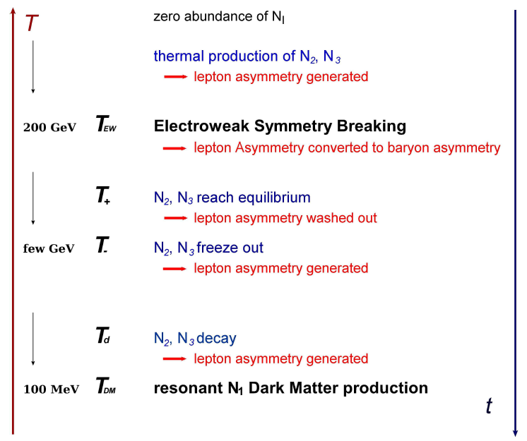
Thermal history in the νMSM
From
1208.4607

Slide 3
Goals
Estimate quality of the density matrix and Boltzmann approximations by comparing results obtained within these approximations to the results obtained in the Kadanoff-Baym formalism.
Study the role of thermal corrections to the masses and widths.

Slide 4
Outline
Simplified setup
Effective masses
CP-violation and symmetries
Boltzmann and density approximations
Beyond Breit-Wigner
Summary

Slide 5

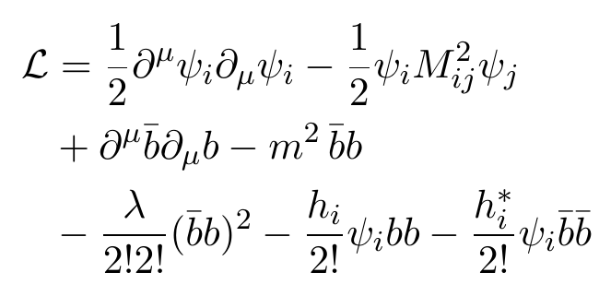
Simplified setup
Notes:
Real scalar ~ Majoranas
Complex scalar ~ leptons
Complex couplings – CP
Universe expansion
Reonance enhancement for small ΔM

Slide 6
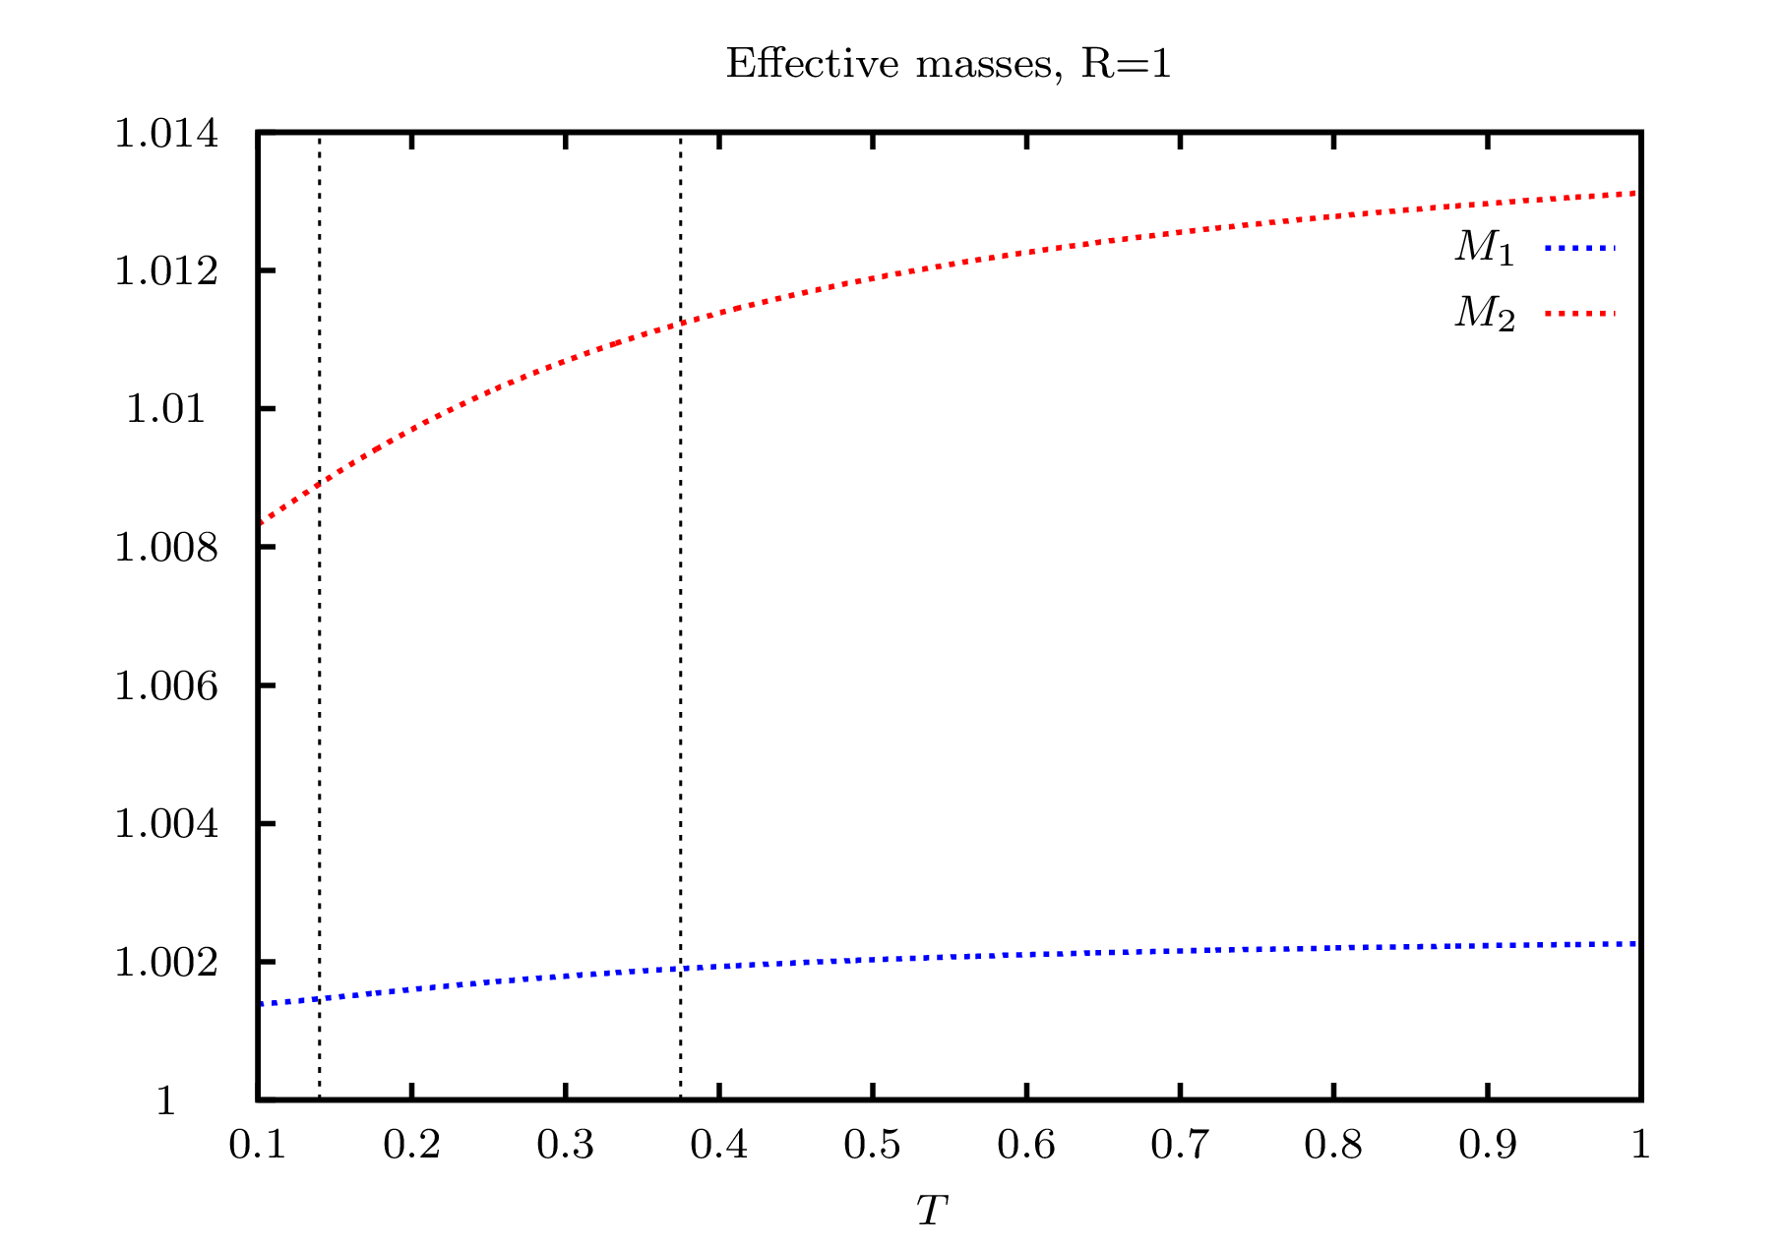
Effective masses (runaway)

Slide 7
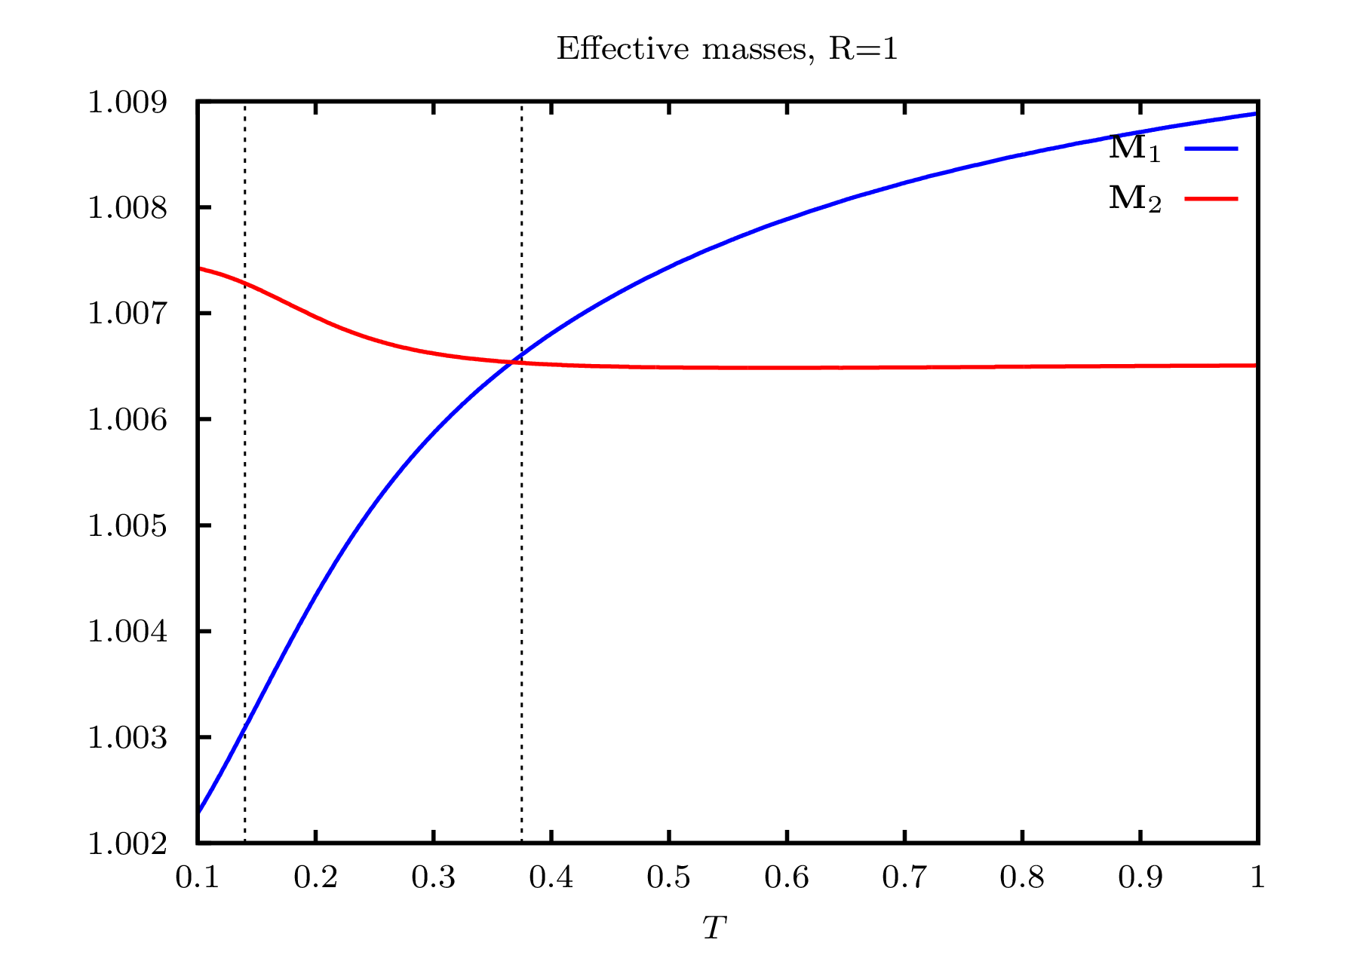
Effective masses (crossing)

Slide 8
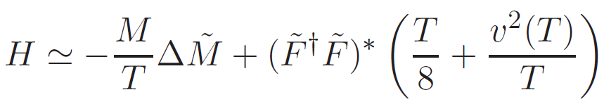
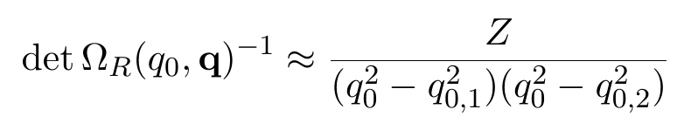
Crossing or avoided crossing ?

Slide 9
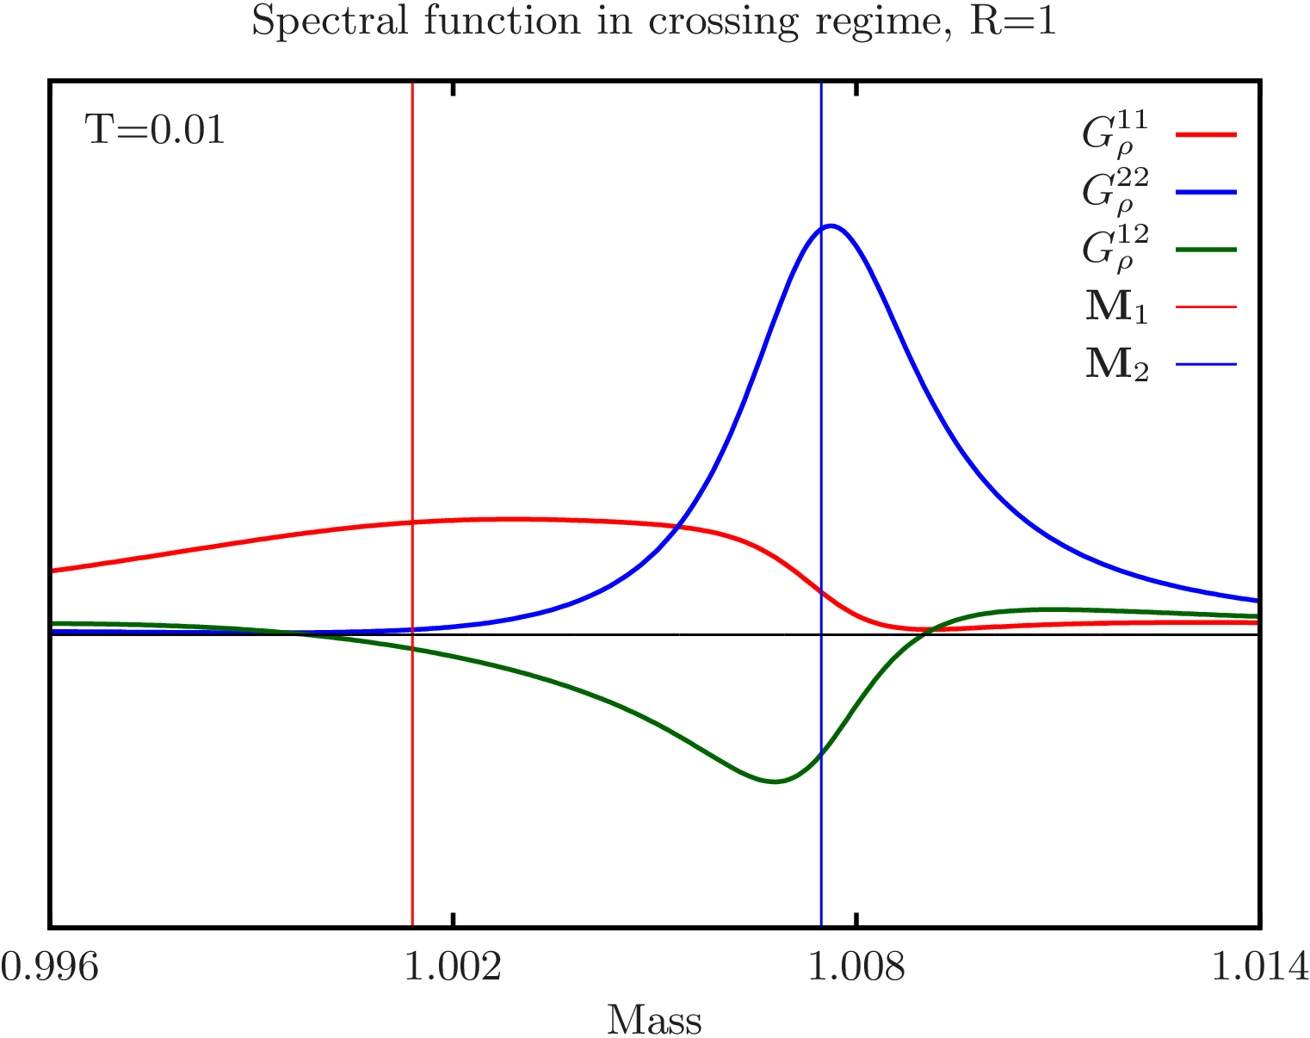
Spectral function

Slide 10
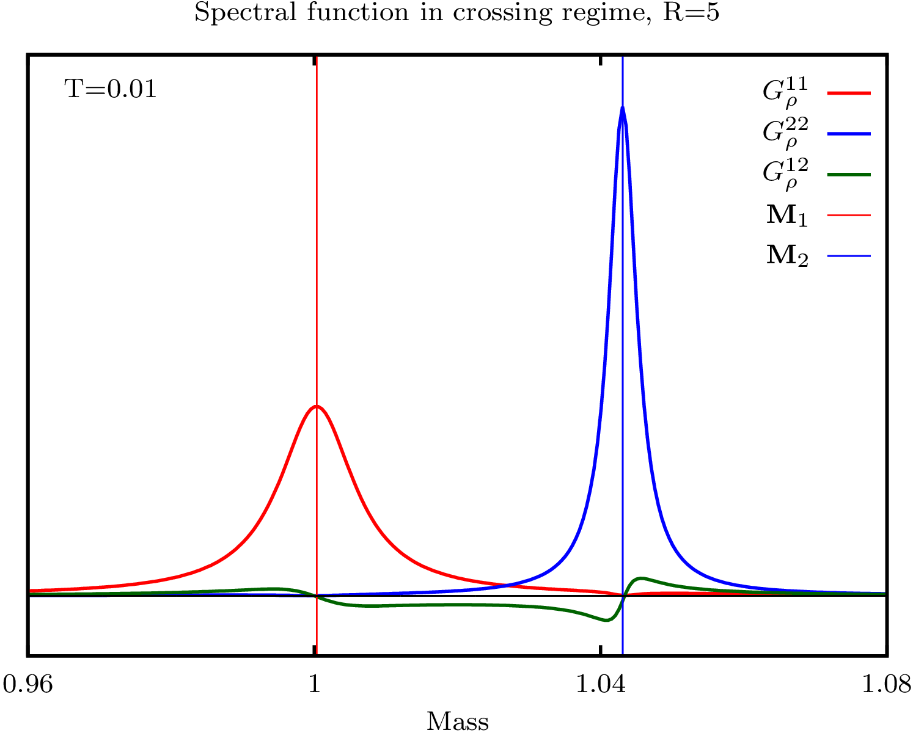
Spectral function

Slide 11
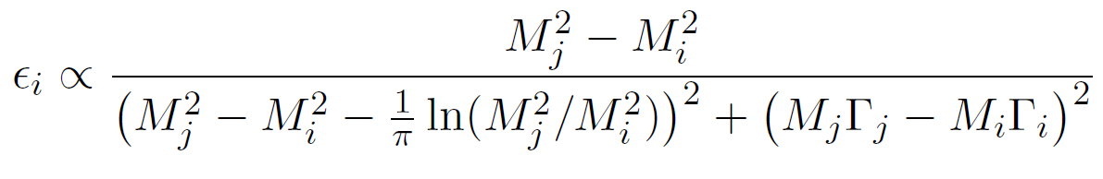
CP-violation and symmetries
Notes:
Vanishes of enhanced ?
Question I addres

Slide 12
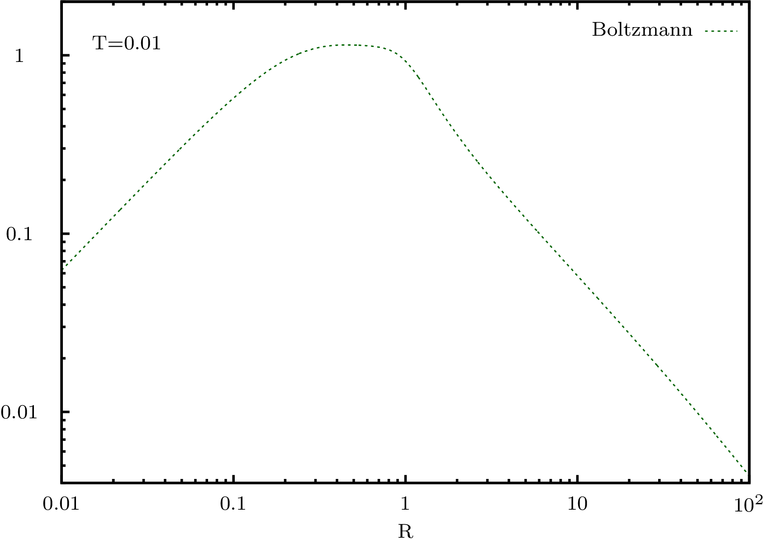
Boltzmann approximation

Slide 13
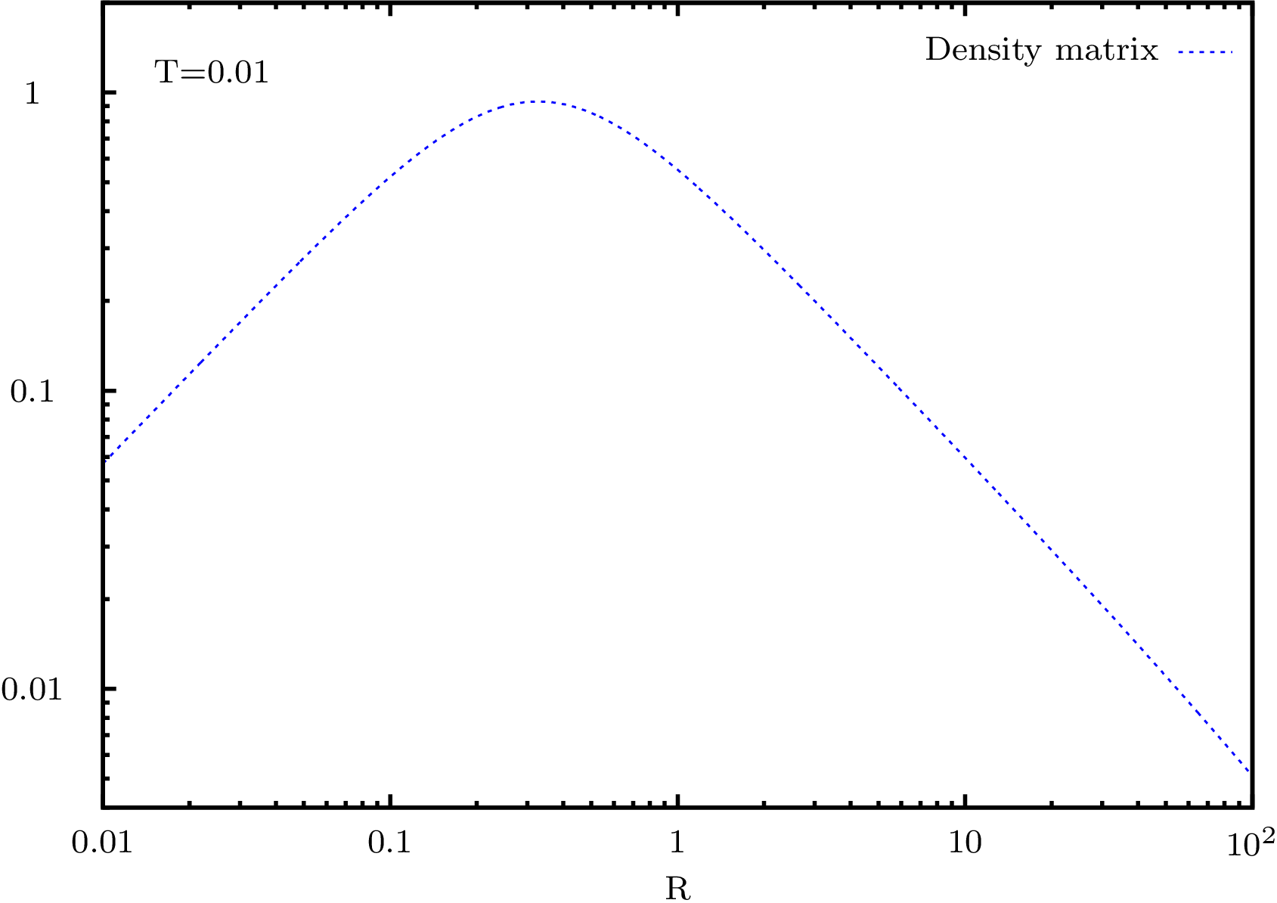
Density matrix approximation

Slide 14
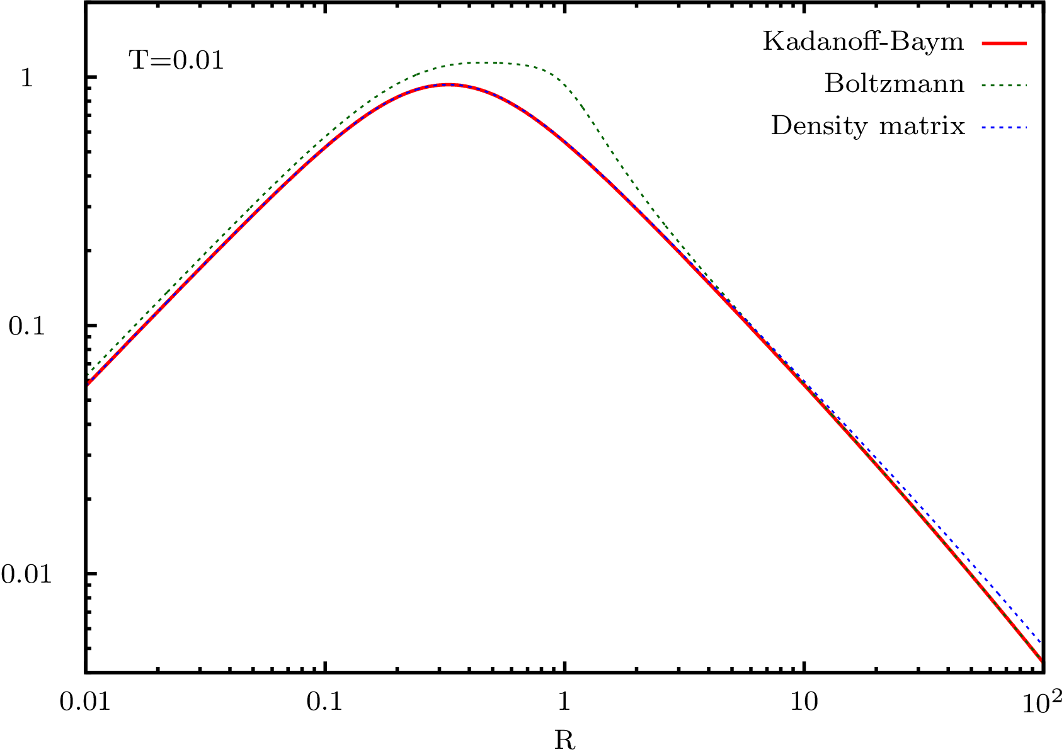
Kadanoff-Baym (effective M and Γ)

Slide 15
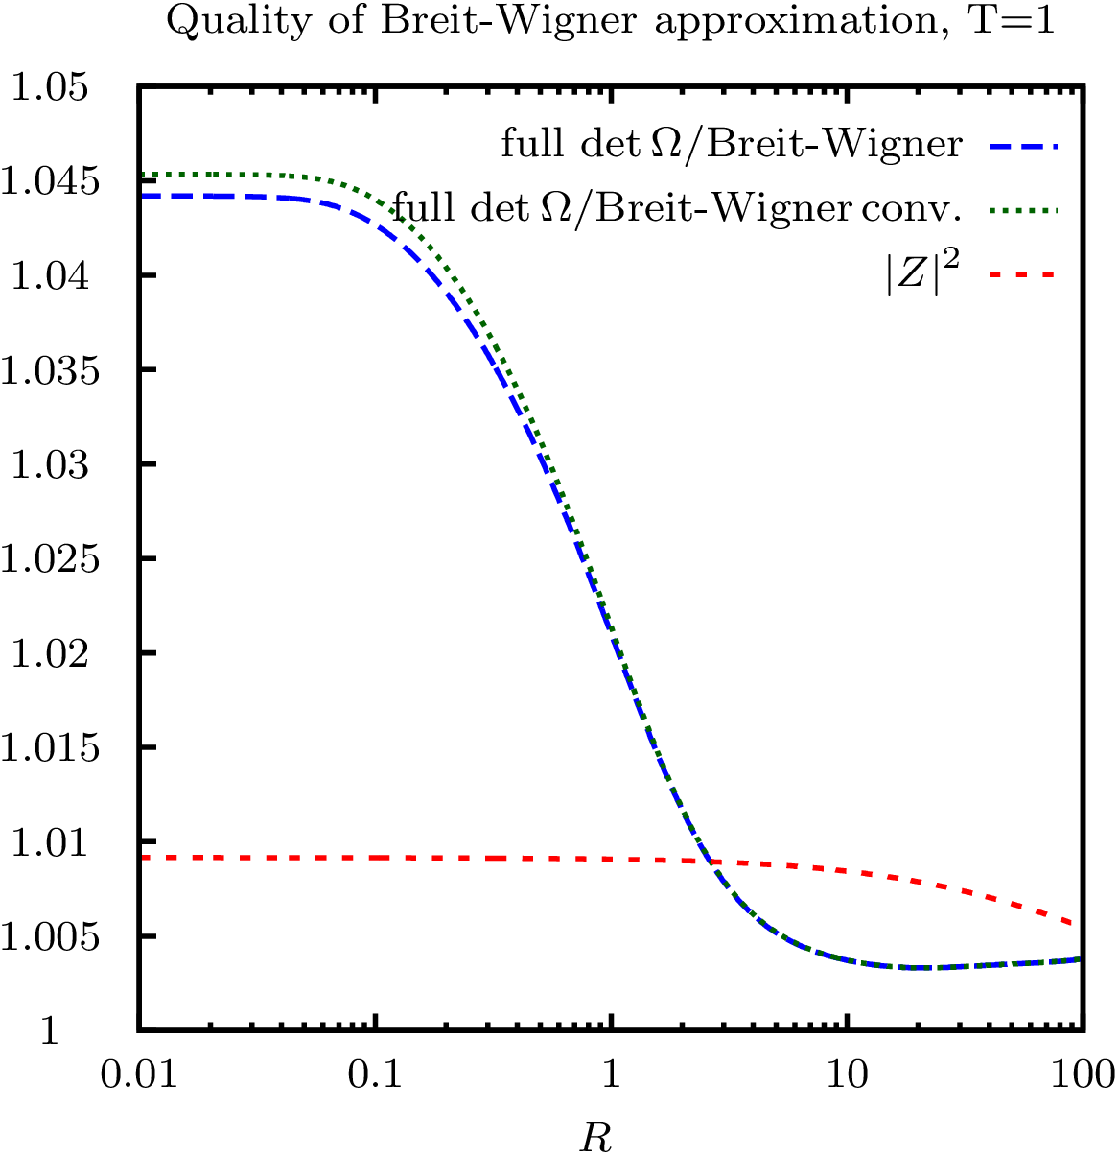
More off-shell efffects
Notes:
Quality of the Breit-Wigner approximation
Use Breit-Winger to extract masses, widths, CP-violation
Corrections below 5%
Density matrix equations in resonant regime.

Slide 16
Summary
Effective masses can run away or cross, leads to subtleties in approximation schemes.
Use of effective masses may lead to spurious CP-violation even in CP-invariant systems.
In the maximally resonant regime Boltzmann approximation is not very good, density matrix is almost perfect.

Slide 17
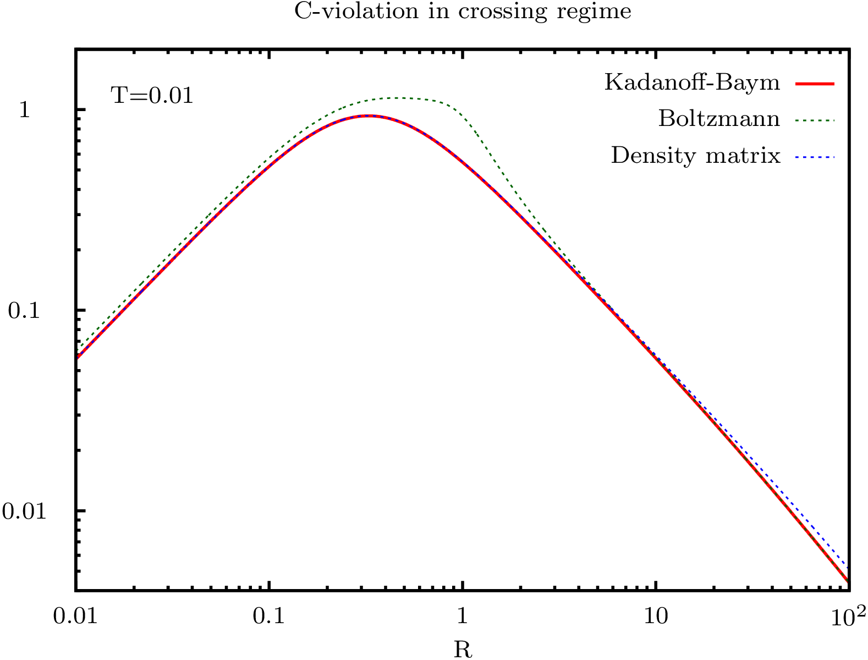

Slide 18
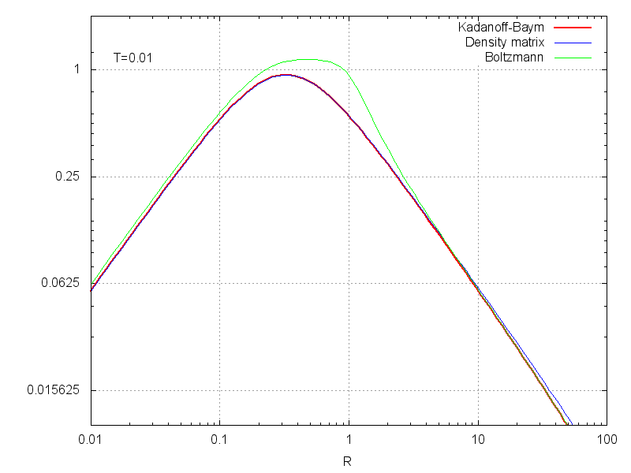

Slide 19
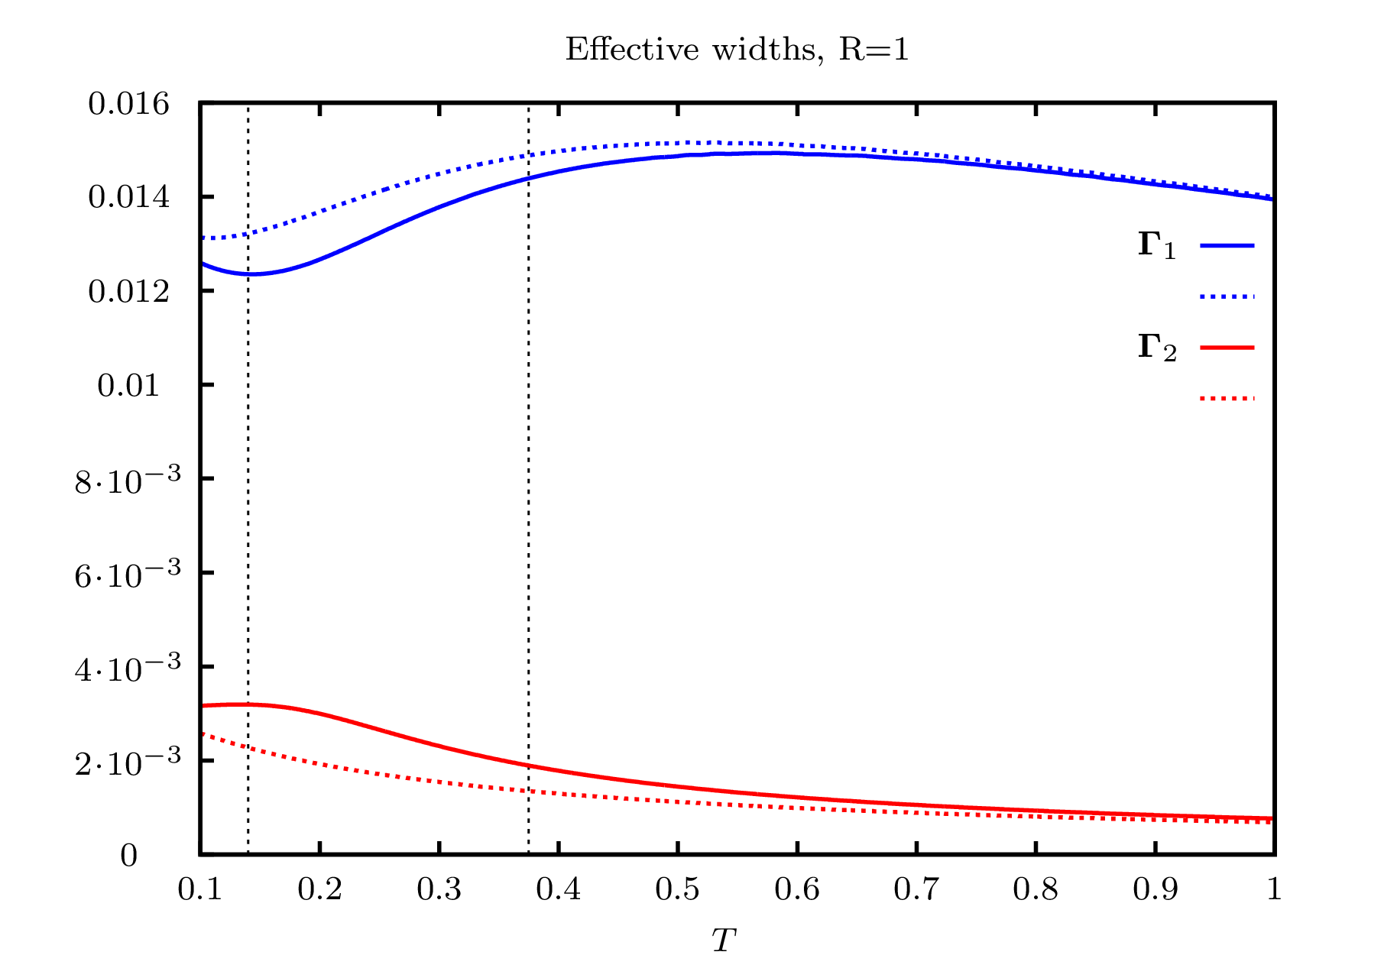

Slide 20
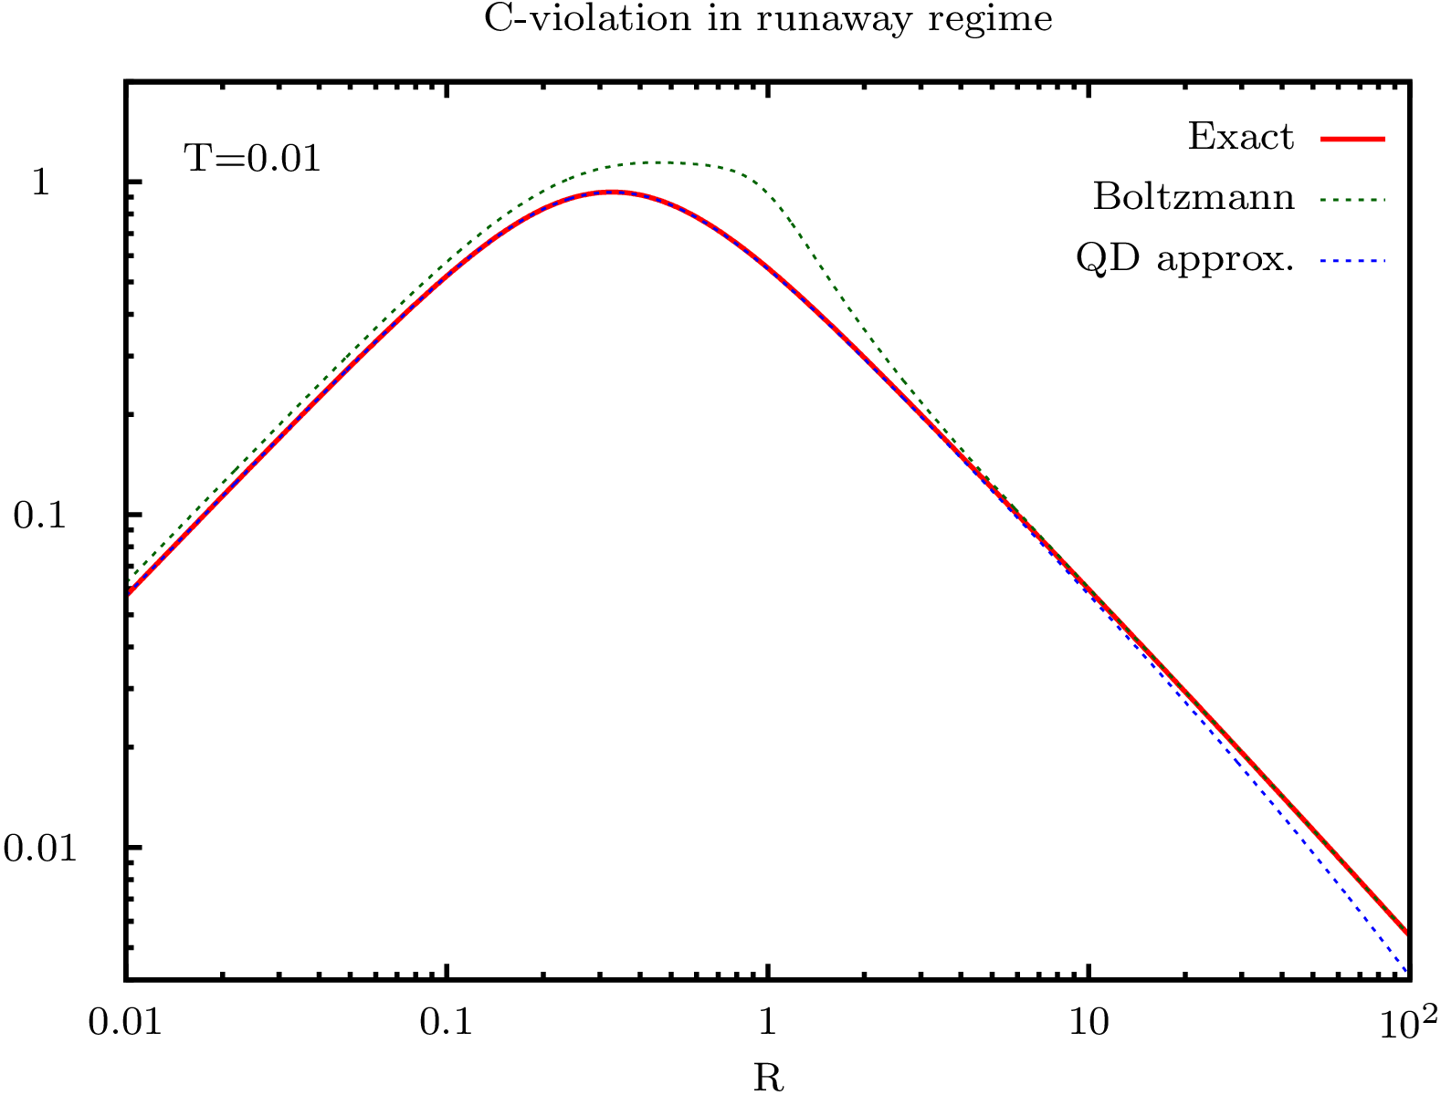

Slide 21
Kadanoff-Baym equations

Slide 22
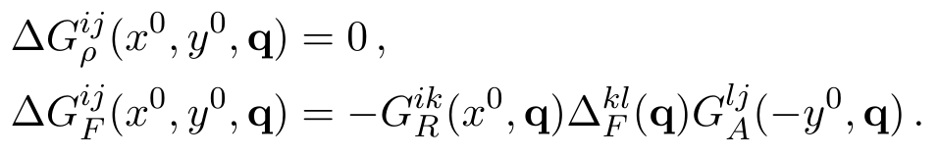
Test solution

Slide 23
Initial conditions

Slide 24
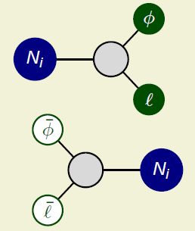
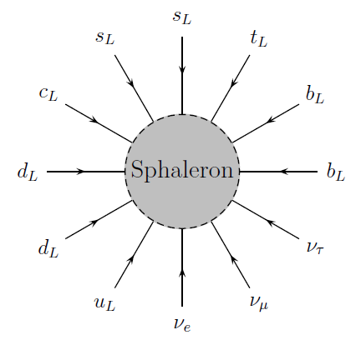
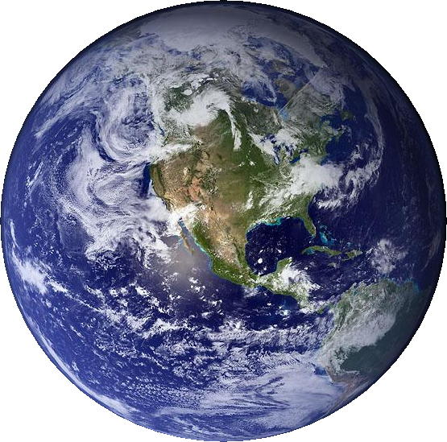
Baryogenesis via leptogenesis
ΔL
ΔB

